Slide 1
STUDENT PERFORMANCE ANALYSIS & PREDICTION SYSTEM
By:
Bharathwaj J,
B.Tech(cse),
The Apollo University

Slide 2
Introduction:
Student Performance analysis plays an important role in understanding the academic progress of students. Educational institutions can use Data Analysis and Machine Learning technique to identify factors affecting performance and predict student outcomes. This project aims to analyze student performance data and develop a machine learning model to predict whether a student will pass or fail.

Slide 3
Technologies Used:
Python,
Pandas,
Matplotlib,
Scikit-Learn,
Jupyter Notebook,
PowerBi,
Streamlit

Slide 4
Problem Statement:
Analyze student performance data.
Identify factors affecting academic performance.
Predict whether a student will pass or fail.
Develop a Machine Learning model for prediction

Slide 5
Flow Of Project:
Data Loading
Data cleaning
Data Preprocesing
Encoding
Train-Test
Model Buliding
Compare Model

Slide 6
Dataset Description:
Dataset Information:
Total Records: 1000
Features: 8
Target: Pass / Fail
Features:
Gender
Race/Ethnicity
Parental Education
Lunch Type
Test Preparation Course
Math Score
Reading Score
Writing Score

Slide 7
Target & Train-Test:
Target Variable:
Pass = Math Score ≥ 40
Fail = Math Score < 40
Train-Test Split:
Training data = 800
Testing data = 200

Slide 8
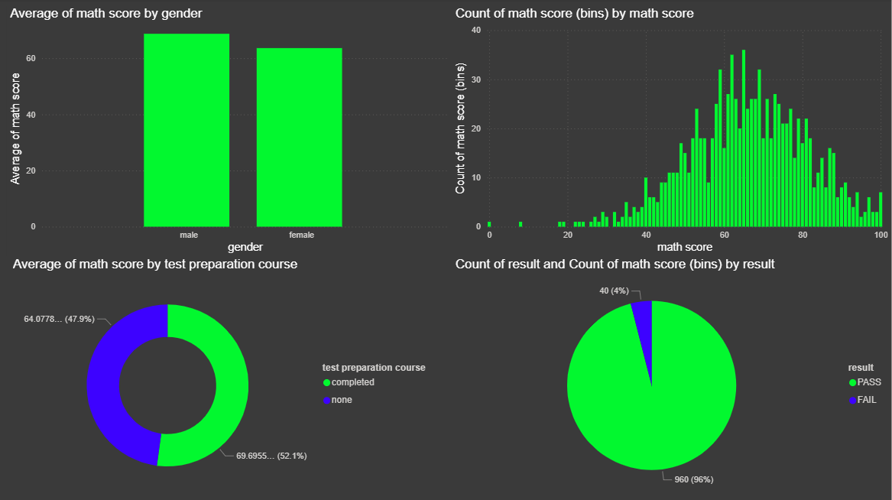
EDA

Slide 9
Logistic Regression:
Logistic Regression is a supervised learning algorithm used for binary classification.
Advantages:
Fast Training
Easy Interpretation
Good Baseline Model
Accuracy Score -> 99.5%
Confusion Matrix:
[[ 10 1]
[ 0 189]]

Slide 10
Decision Tree:
Decision Tree creates rules based on input features.
Advantages:
Easy Visualization
Feature Importance
High Interpretability
Accuracy Score -> 100.0%
Confusion Matrix:
[[ 11 0]
[ 0 189]]

Slide 11
K-Nearest Neighbors (KNN):
KNN classifies data based on nearest neighbors.
Advantages:
Simple Algorithm
Effective Classification
No Training Complexity
Accuracy Score -> 99.5%
Confusion Matrix:
[[ 10 1]
[ 0 189]]

Slide 12
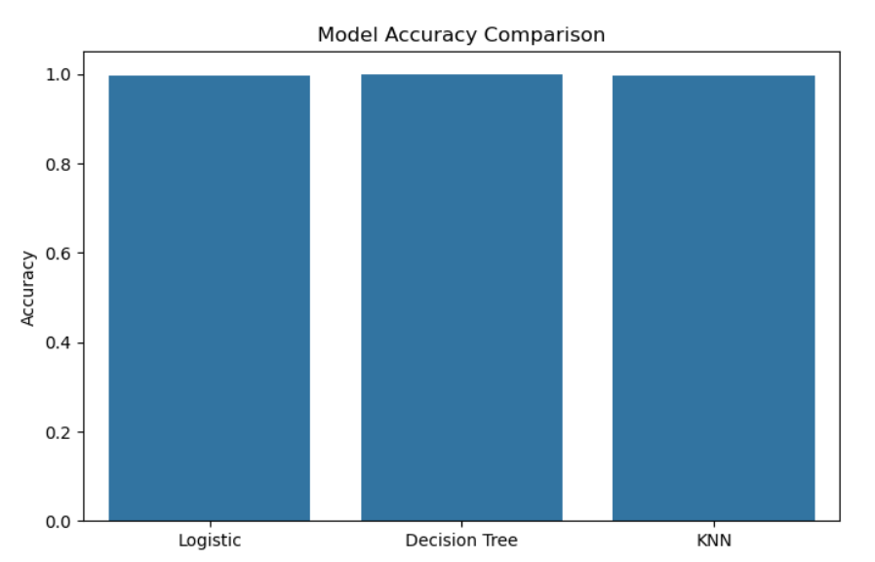
Model Comparsion:

Slide 13
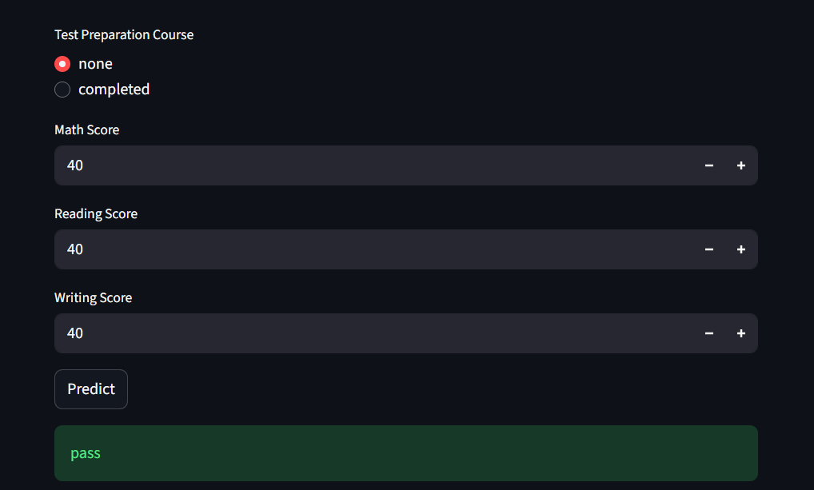
Streamlit App:

Slide 14
Conclusion:
Successfully analyzed student performance.
Built Machine Learning models.
Compared multiple algorithms.
Deployed using Streamlit.

Slide 15
---- THANK YOU----

